Slide 1

Functions in CPP
Date: 31st July 2020
By: Amit Kumar Trivedi
KHYATI SCHOOL OF COMPUTER APPLICATION

Slide 2
Introduction
Basics of Function.
Different types of Function
Function and Class
Function which takes class object as argument
Function which returns class object as value

Slide 3
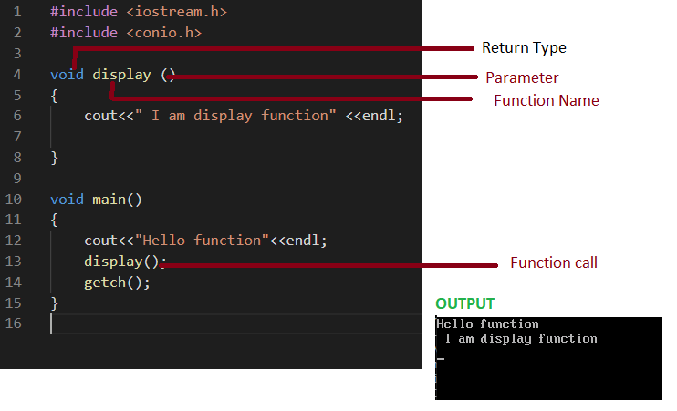
Basics of Function
Simple Functions which takes no argument and return nothing.

Slide 4
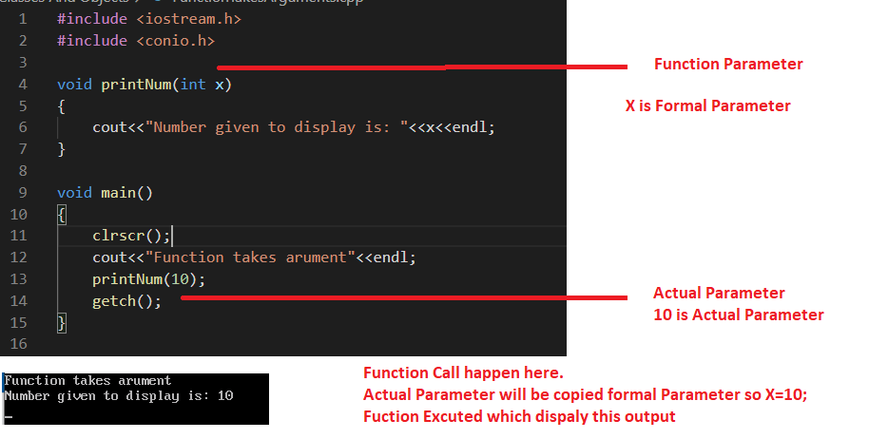
Functions Parameters
Function which take one arguments/parameter

Slide 5
Function calling Mechanism
When function encounter
Hold the execution of the current program
Check if function exist
Do function call
Copy actual parameter to formal parameter
Start execution of the called function
When completed
Return Function
Resume the execution from paused point

Slide 6
Dry Run
Step 1
(function call : printme p1=34)
Step 7
p1=34
Step 9
(function return to main)
Step 10
(fucntion call p1=63)
Step 7
p1=63
Step 9
(function

Slide 7
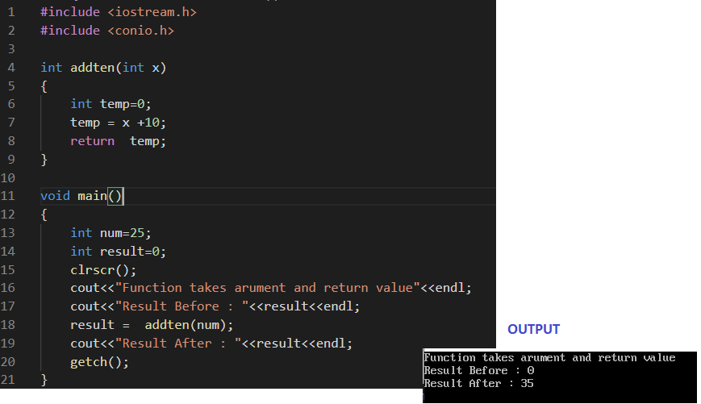
Functions returns value
Simple Functions which takes argument and return VALUE

Slide 9
Assignment
Create a function called sum.
Which takes two numbers as argument.
Function Return sum of the number passed in the argument.

Slide 10
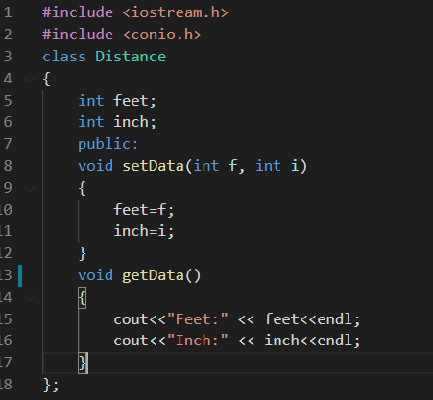
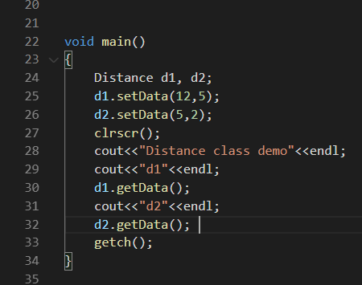
Distance Class
Distance class with two data member feet and inch and two member function set data and get data.

Slide 11
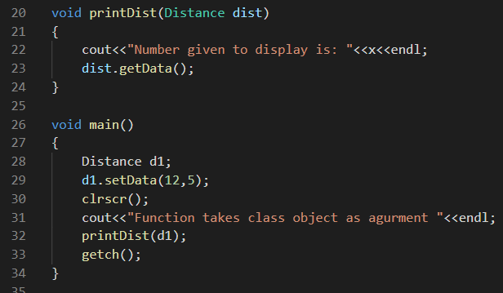
Passing Class Objects to Function
Function which takes calls object as its parameter

Slide 12
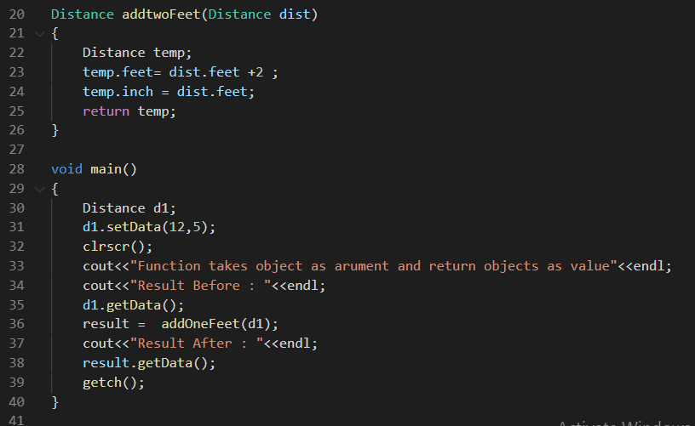
Returning Objects from Functions
Function which return object

Slide 13
Dry Run
Function call printDist(d1)
Void printDist(Distance x)
Distance x=d1;
X
{
int feet=5;
int inch=6;
}
x.feet =d1.feet= 5
x.inch = d1.inch=6
cout<< "Inside Distance"
x.getData();
Cout<< "feet "<< feet=5
Feet 5
inch 6;
int sum=0;
Distance d1;
Creats and object of distance class named d1;
Memory Allocation
---------------
d1 {
int feet=5:
int inch=6;
}
setdata function will call on d1.
d1.setData(5,6)
int x=5, int y=6;
feet=x=5;
inch = y = 6;
Clear screen

Slide 14
Practice Box Class
Create a Box Class with below specification.
Width as data member
Height as data member
GetData and setData as the Member functions.
Create object of class
Create non member function printBox which takes Box object as argument
and display Data of passed box’s object .
Create another member name newBox which takes box object as argument and
Return new box which has width double of the passed object box.

Slide 15
Summary
What is Function
Anatomy of function.
Function calling
Function with no argument and return nothing
Function with argument and return nothing
Function with argument and return Value
Practice for Sum Function
Distance Class
Function Take class object as argument
Function Take class object as argument and return class object as value.
Practice Box Class

Slide 16
Thank you

